Slide 1
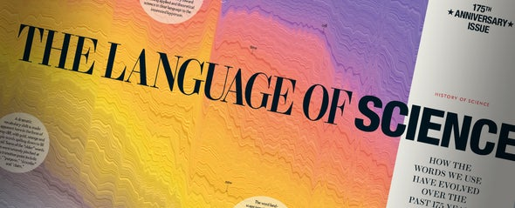
Case Study
125 years of words in Scientific American

Slide 2

A visualization by Moritz Stefaner
German data visualization specialist,
Participated in important projects
Winner of several contests
Website: https://truth-and-beauty.net/
Podcast: https://datastori.es/ Data stories with Enrico Bertini
Interesting, current project: WHO Data Design Language

Slide 3
Step 1: The project - vision and goals
Dig deep in Scientific American Archive from 1845 to 2020 to show how language evolved through these years.
5107 editions (1845 to 1993 predigital, scanned and OCR)
199,694 pages
110,292,327 words
Goal:
Commemorate the event
Reflect on the evolution of language
Entertain

Slide 4
Step 1: The project – Audience and medium
Audience:
Scientific American fans
Historians
but also
Plain readers
Medium:
Paper (special article)
Digital (interactive, simpler visualization)

Slide 5
Step 2: First ideas
Is the dataset worth the visualization?
Possible questions:
Trends in issues / through years
Unit of analysis
Sentence lengths
Terms (two or three words)
Interpunctuation styles (exclamations, question marks)
Persons and places

Slide 6
Step 2: Exploration of data: limitations
OCR errors, impossible to work with pairs or three words
No terms
No places
No persons
Issue level full of small word recognition errors
Decision: Yearly level, Individual words

Slide 7
Step 2: Exploration insights
What or How?
Few repetitive words (4000), long tail
Importance of frequency
Absolute or Relative?
The amount of words has changed a lot over the years

Slide 8
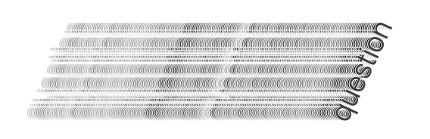
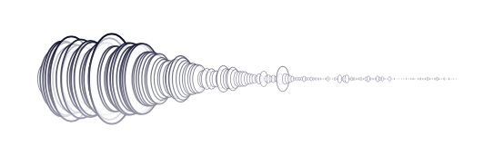
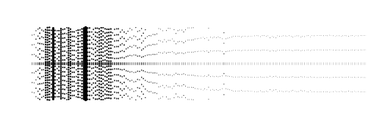
Step 3: Charts and encodings, first sketches
Trials: Individual words evolution

Slide 9
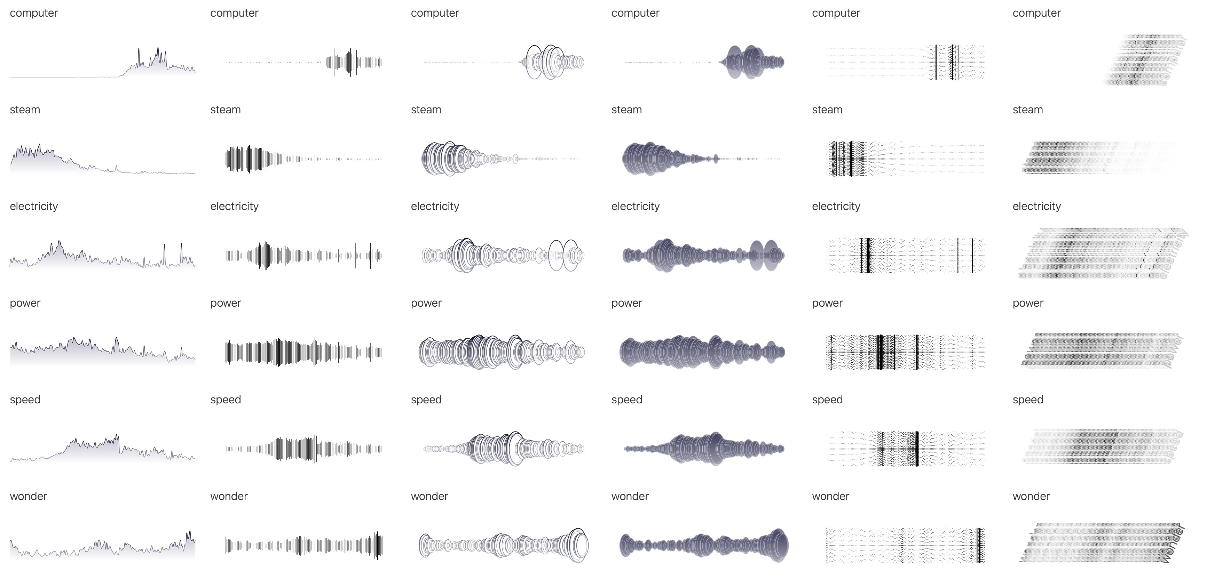
Step 3: Charts and encodings, more sketches

Slide 10
Step 3: Choosing a chart
Word clouds
Stack area graphs – For a global view
Line charts – For the evolution of each word
Animations
Spatial maps
Semantic spaces
Small multiples
Word clouds
Stack area graphs
Line charts
Animations
Spatial maps
Semantic spaces

Slide 11
Step 4: Implementation
Taking into account medium restrictions and possibilities
Clarity, design, final touches
Colour encoding: for aesthetical and meaning reasons, from vintage brown trough yellow, orange to modern purple

Slide 12
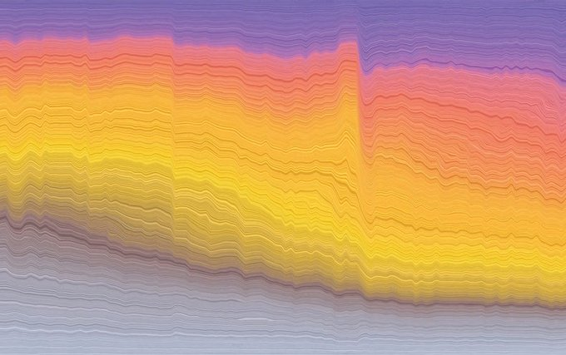
4: Final cover view, on paper: Stacked area chart
Stack area chart where newer words area stacked on top of the older ones – showing the major breaks and shifts in the vocabulary akin to soil layers

Slide 13
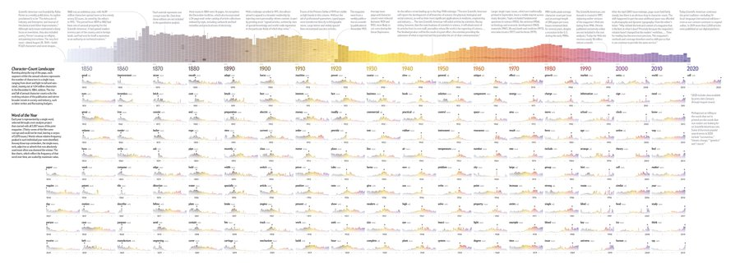
4: Final inside view, on paper

Slide 14
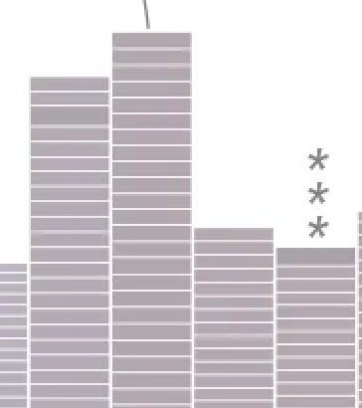
4: Paper, character-count Landscape
Each segment within the annual column represents the number of characters in a single issue, ranging form short and light to tall and saturated, maxing out at 1.04 million characters in the December 6, 1884, edition.

Slide 15
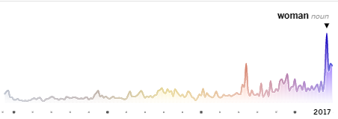
4: Paper, Word of the year
Each year is represented by a single word,
Selected through a text-analysis project of the print magazine. Words whose relative frequency peaked in each individual year were identified. The single noun, verb, adjective or adverb that was absolutely used most often was deemed the winner.
The line charts, which reflect the frequency of that word over time, are scaled by maximum value.

Slide 16
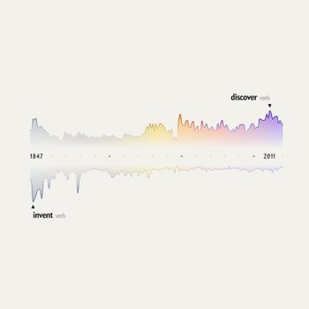
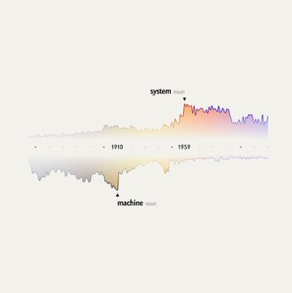
4: Paper, Comparison of words
It also features a couple of hand-picked juxtapositions, to show how the magazine's perspective has changed — from "machine" to "system" or "invent" to "discover".
Serendipity + Curation criteria

Slide 17
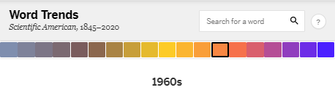
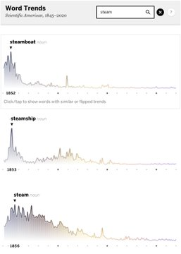
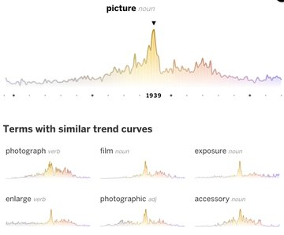
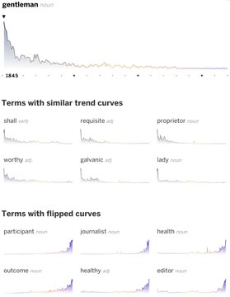
4: Digital, interactivity
Search function
Similar trend curves
Similar / Flipped trend curves

Slide 18
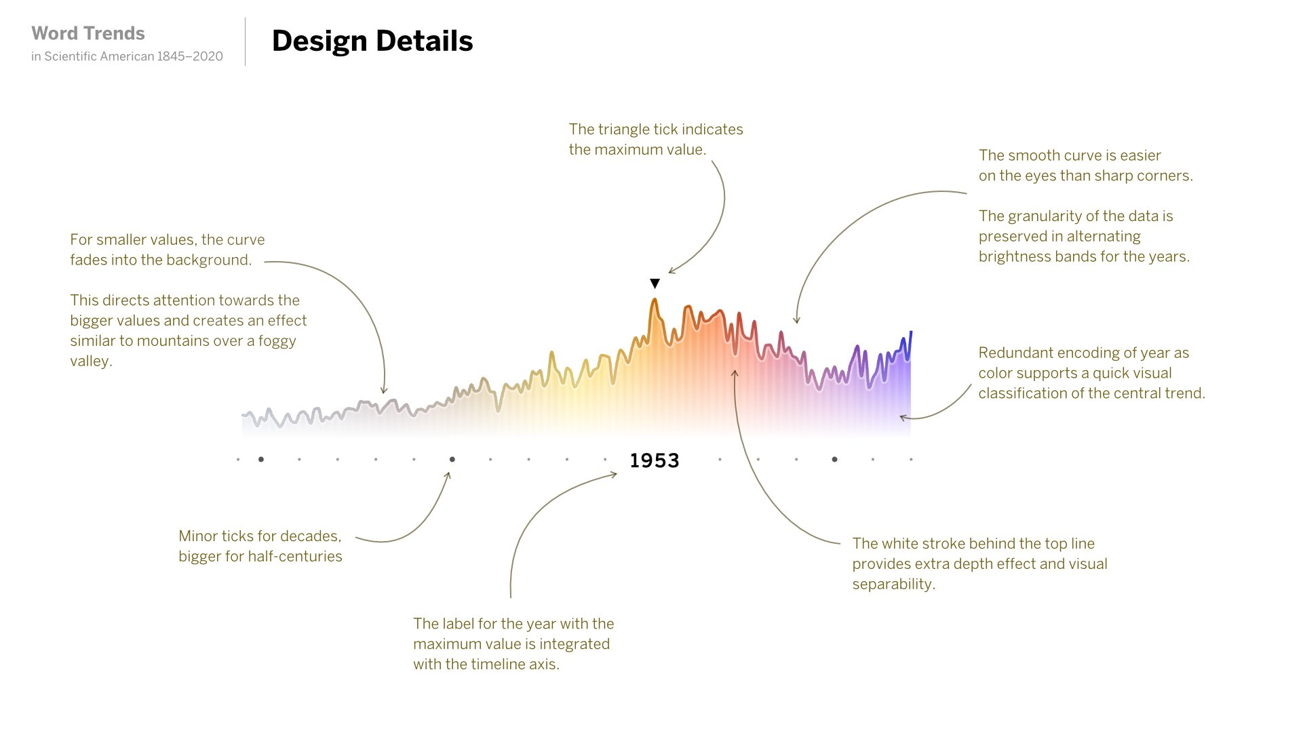
4: Refining and finishing details

Slide 19
References
S2E7 - JEN CHRISTIANSEN & MORITZ STEFANER - 175 years of word usage patterns in Scientific American, within Explore Explain, by Andy Kirk https://www.youtube.com/watch?v=EvWEEoh0d8E
Moritz Stefaner, Lorraine Daston, Jen Christiansen “The Language of Science: How the words we use have evolved over the past 175 years” Scientific American, September 1, 2020 https://www.scientificamerican.com/article/the-language-of-science/
Moritz Stefaner, How to turn 175 years of Words in Scientific American into an Image: a data designer explains the art and science of analyzing and charting text from 5107 issues of this magazine. Scientific American, September 1, 2020 https://www.scientificamerican.com/article/how-to-turn-175-years-of-words-in-scientific-american-into-an-image/
Moritz Stefaner, Explore 175 Years of Words in Scientific American. Scientific American, August 18, 2020 https://www.scientificamerican.com/article/explore-175-years-of-words-in-scientific-american/
Moritz Stefaner, report on Twitter on the making-off https://twitter.com/moritz_stefaner/status/1295733727704875010
https://mobile.twitter.com/hashtag/SciAm175
https://twitter.com/hashtag/sciencewords

